Slide 1


Student Performance Analytics
using Data Mining and Machine Learning
MINI PROJECT :
  AYUSH SHAH : 1262241607
  SNEHA SHARMA 1262241771
01

Slide 2

Introduction
Data Mining in Education
Transforming Education Through Analytics
DATA MINING ENABLES EDUCATORS TO DISCOVER HIDDEN PATTERNS IN STUDENT DATA, PREDICT PERFORMANCE OUTCOMES, AND IDENTIFY AT-RISK STUDENTS EARLY
•PREDICTIVE ANALYTICS FOR EARLY INTERVENTION
•PERSONALIZED LEARNING PATHWAYS
•EVIDENCE-BASED EDUCATIONAL POLICIES
•RESOURCE OPTIMIZATION IN INSTITUTIONS
02

Slide 3


Problem Statement
Student performance is influenced by a complex interplay of multiple factors that traditional assessment methods cannot fully capture.
Academic Factors
  Study hours and attendance
  Previous academic records
  Test scores and assignments
Behavioral Factors
  Motivation levels
  Participation in class
  Learning engagement
Socio-Economic Factors
  Family income and support
  Parental education level
  Access to resources
ENVIRONMENTAL FACTORS
  SCHOOL INFRASTRUCTURE
  PEER INFLUENCE
  LEARNING ENVIRONMENT
03

Slide 4



Project Objectives
  Data Collection & Integration
Gather comprehensive student data from multiple sources including academic records, behavioral observations, and socio-economic surveys
  Pattern Discovery
Apply data mining techniques to uncover hidden correlations and trends affecting student performance
  Predictive Modeling
Develop machine learning models to accurately predict student outcomes and identify at-risk individuals
  Visualization & Insights
Create intuitive visual dashboards to present actionable insights for educators and administrators
04

Slide 5


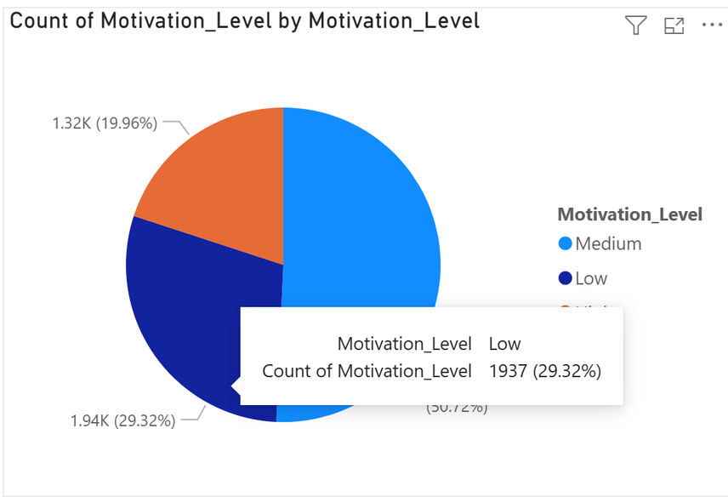
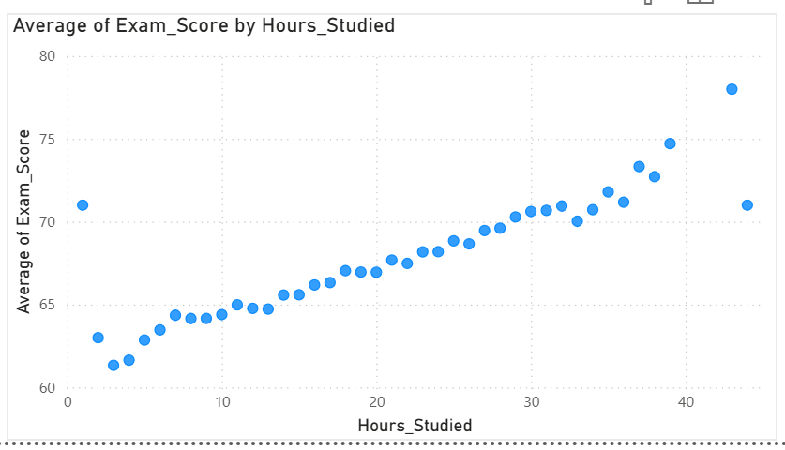

Dataset Description
THE PIE CHART ILLUSTRATES THE DISTRIBUTION OF STUDENTS ACROSS DIFFERENT MOTIVATION LEVELS. IT HIGHLIGHTS HOW MOTIVATION IS SPREAD WITHIN THE DATASET AND HELPS IDENTIFY WHETHER MOST STUDENTS FALL INTO LOW, MEDIUM, OR HIGH MOTIVATION CATEGORIES. THIS INSIGHT IS IMPORTANT AS MOTIVATION DIRECTLY INFLUENCES ACADEMIC PERFORMANCE AND LEARNING CONSISTENCY.
THIS GRAPH SHOWS THE RELATIONSHIP BETWEEN STUDY HOURS AND AVERAGE ACADEMIC PERFORMANCE. IT INDICATES A POSITIVE TREND WHERE INCREASED STUDY HOURS GENERALLY LEAD TO HIGHER SCORES. HOWEVER, BEYOND A CERTAIN POINT, THE IMPROVEMENT MAY STABILIZE, SUGGESTING THAT CONSISTENCY AND EFFECTIVE STUDY STRATEGIES ARE EQUALLY IMPORTANT.
05

Slide 6

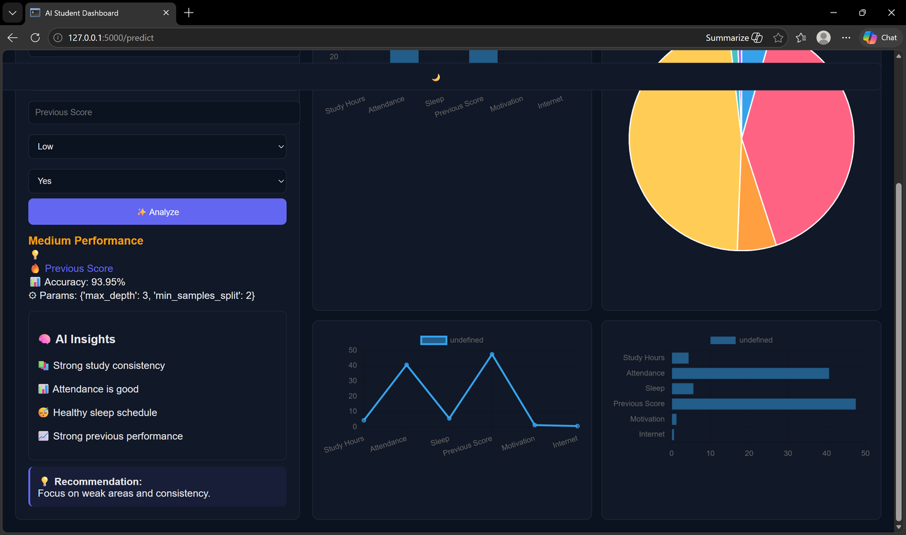

DASHBOARD
  PREDICTS STUDENT PERFORMANCE BASED ON MULTIPLE INPUT FACTORS
  DISPLAYS REAL-TIME VISUALIZATIONS THAT UPDATE DYNAMICALLY
  PROVIDES AI-BASED INSIGHTS HIGHLIGHTING STRENGTHS AND WEAKNESSES
  IDENTIFIES THE MOST INFLUENTIAL FACTOR AFFECTING PERFORMANCE
  GENERATES PERSONALIZED RECOMMENDATIONS FOR IMPROVEMENT
  OFFERS AN INTERACTIVE AND USER-FRIENDLY INTERFACE
11

Slide 7


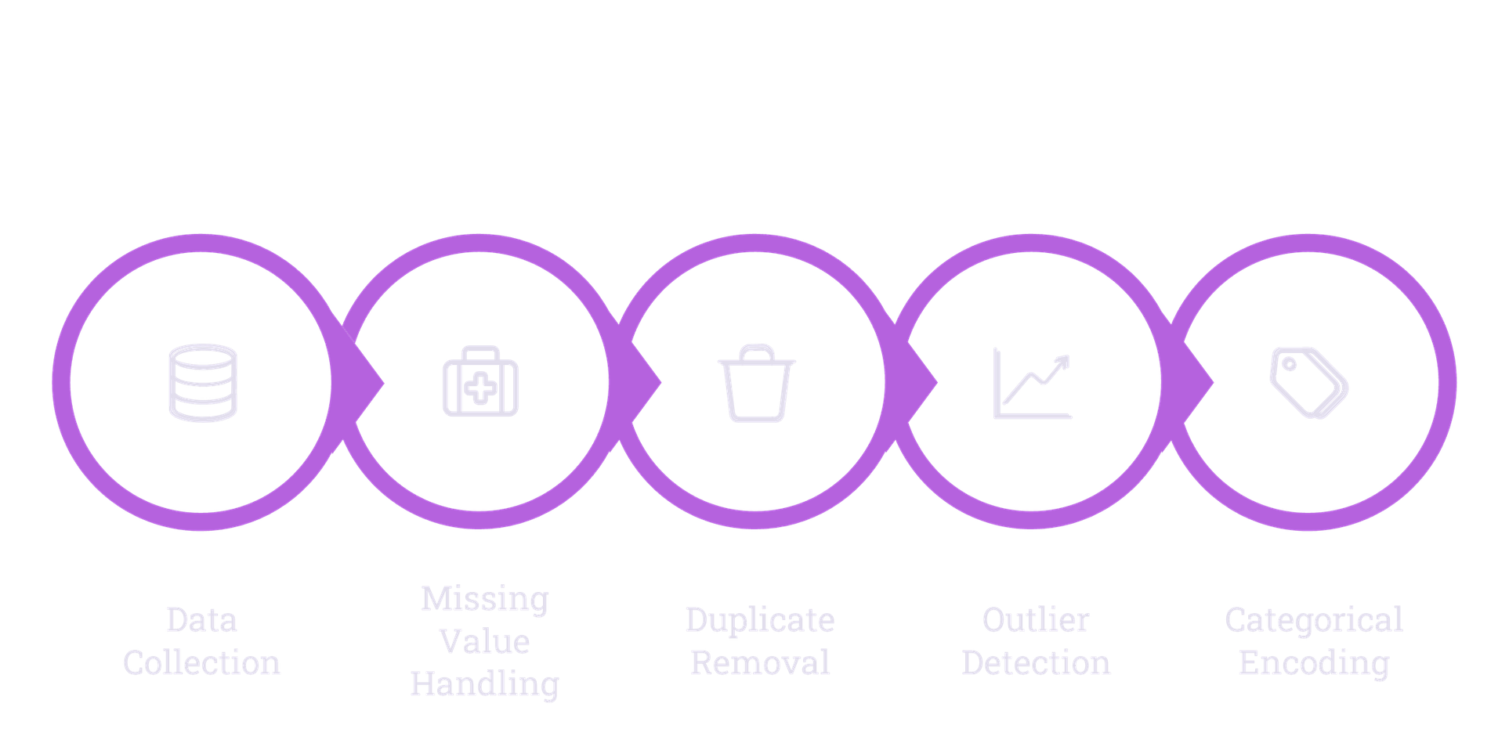

Data Preprocessing Pipeline
Clean, transform, and prepare raw data for analysis through systematic preprocessing steps.
06

Slide 8



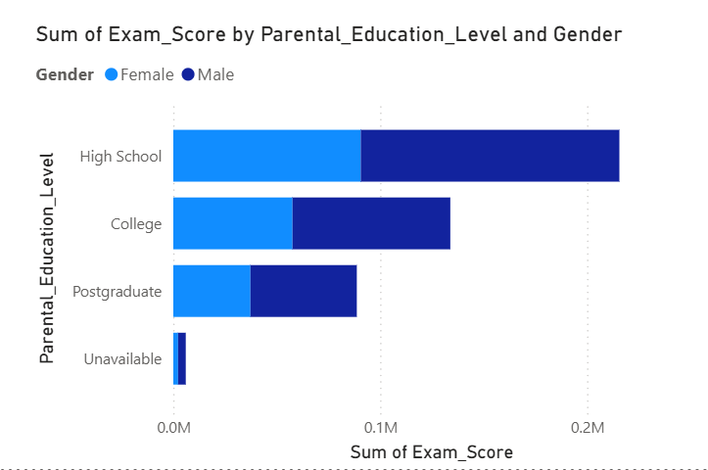
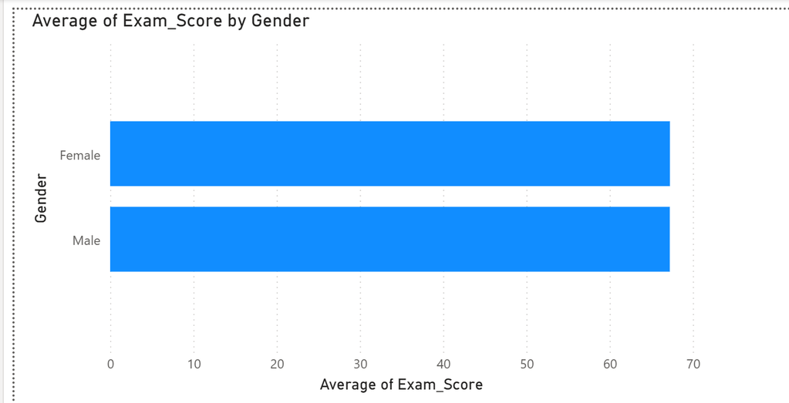


Statistical
Analysis
  USED TO UNDERSTAND DATA DISTRIBUTION AND OVERALL PATTERNS
  MEAN AND MEDIAN HELP IDENTIFY CENTRAL TENDENCY OF VALUES
  STANDARD DEVIATION MEASURES VARIATION IN THE DATASET
  MINIMUM AND MAXIMUM VALUES DEFINE THE DATA RANGE
  Z-SCORE IS USED TO STANDARDIZE DATA AND DETECT OUTLIERS
  SUPPORTS BETTER PREPROCESSING AND IMPROVES MODEL PERFORMANCE
07

Slide 9


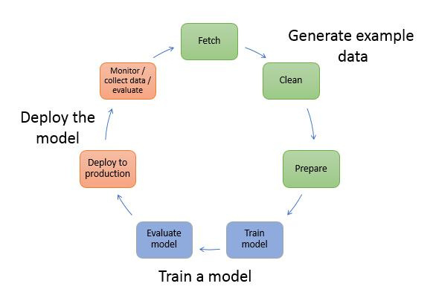

System
Architecture
THE SYSTEM ARCHITECTURE BEGINS WITH THE USER ENTERING STUDENT-RELATED DATA THROUGH THE WEB INTERFACE. THIS INPUT DATA IS THEN PREPROCESSED BY PERFORMING STEPS SUCH AS DATA CLEANING, ENCODING OF CATEGORICAL VALUES, AND VALIDATION. THE PROCESSED DATA IS PASSED TO THE MACHINE LEARNING MODEL, WHERE A DECISION TREE CLASSIFIER PREDICTS THE STUDENT’S PERFORMANCE CATEGORY. BASED ON THIS PREDICTION, THE SYSTEM GENERATES AI-DRIVEN INSIGHTS AND RECOMMENDATIONS TO HIGHLIGHT STRENGTHS AND AREAS FOR IMPROVEMENT. FINALLY, THE RESULTS ARE PRESENTED THROUGH AN INTERACTIVE DASHBOARD, WHERE VISUALIZATIONS HELP USERS UNDERSTAND THE KEY FACTORS INFLUENCING PERFORMANCE AND MAKE INFORMED DECISIONS.
08

Slide 10




Machine Learning
Algorithms
DECISION TREE
  HIERARCHICAL TREE STRUCTURE THAT SPLITS DATA BASED ON FEATURE VALUES. CREATES INTUITIVE DECISION RULES THAT ARE EASY TO VISUALIZE AND EXPLAIN TO STAKEHOLDERS.
LOGISTIC REGRESSION
  LINEAR MODEL FOR BINARY CLASSIFICATION PREDICTING PASS/FAIL OUTCOMES. PROVIDES PROBABILITY ESTIMATES AND INTERPRETABLE COEFFICIENTS FOR FEATURE IMPORTANCE ANALYSIS.
RANDOM FOREST
  ENSEMBLE OF DECISION TREES PROVIDING ROBUST PREDICTIONS THROUGH MAJORITY VOTING. REDUCES OVERFITTING AND IMPROVES ACCURACY BY COMBINING MULTIPLE WEAK LEARNERS.
09

Slide 11

Model Evaluation & Results
Evaluation Metrics
85%
88%
83%
ACCURACY
PRECISION
RECALL
REPRESENTS THE OVERALL CORRECTNESS OF THE MODEL. AN ACCURACY OF 85% INDICATES THAT THE MODEL PREDICTS THE STUDENT PERFORMANCE CORRECTLY IN MOST CASES.
MEASURES HOW ACCURATE THE POSITIVE PREDICTIONS ARE. A PRECISION OF 88% SHOWS THAT WHEN THE MODEL PREDICTS A CATEGORY, IT IS USUALLY CORRECT.
INDICATES HOW WELL THE MODEL IDENTIFIES ACTUAL CASES. A RECALL OF 83% MEANS THE MODEL SUCCESSFULLY CAPTURES MOST OF THE RELEVANT OUTCOMES.
KEY INSIGHTS
  STUDY HOURS AND ATTENDANCE SHOW STRONGEST CORRELATION WITH PERFORMANCE
  Motivation scores significantly impact outcomes
  Family income has moderate influence on results
  Model successfully identifies 83% of at-risk students
10

Slide 12
thank
you!
15

